Slide 1
CSC 334 – Parallel and Distributed Computing
Instructor: Ms. Muntha Amjad
Lecture# 04: Designing Parallel Programs

Slide 2
Agenda
Automatic vs. Manual Parallelization
Understand the Problem and the Program
Partitioning
Communications
Synchronization
Data Dependencies
Load Balancing
Granularity
I/O
Performance Analysis and Tuning
Limits and Costs of Parallel Programming

Slide 3
Automatic vs. Manual Parallelization
Designing and developing parallel programs has characteristically been a very manual process. The programmer is typically responsible for both identifying and actually implementing parallelism.
Very often, manually developing parallel codes is a time consuming, complex, error-prone and iterative process.
Various tools have been available over the years to assist the programmer with converting serial programs into parallel programs. The most common type of tool used to automatically parallelize a serial program is a parallelizing compiler or pre-processor.

Slide 4
Automatic vs. Manual Parallelization
A parallelizing compiler generally works in two different ways:
  Fully Automatic
    The compiler analyzes the source code and identifies opportunities for parallelism.
    The analysis includes identifying inhibitors to parallelism and possibly a cost weighting on whether or not the parallelism would actually improve performance.
    Loops (do, for) loops are the most frequent target for automatic parallelization.
  Programmer Directed
    Using "compiler directives" or possibly compiler flags, the programmer explicitly tells the compiler how to parallelize the code.
    May be able to be used in conjunction with some degree of automatic parallelization also.
    The most common compiler generated parallelization is done using on-node shared memory and threads (such as OpenMP).

Slide 5
Automatic vs. Manual Parallelization
If you are beginning with an existing serial code and have time or budget constraints, then automatic parallelization may be the answer. However, there are several important caveats/limitations that apply to automatic parallelization:
  Wrong results may be produced
  Performance may actually degrade
  Much less flexible than manual parallelization
  Limited to a subset (mostly loops) of code
  May actually not parallelize code if the analysis suggests there are inhibitors, or the code is too complex
  Most automatic parallelization tools are for Fortran
The remainder of the lecture applies to the manual method of developing parallel codes.

Slide 6
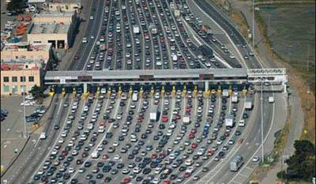
Understand the Problem and the Program
Undoubtedly, the first step in developing parallel software is to first understand the problem that you wish to solve in parallel. If you are starting with a serial program, this necessitates understanding the existing code also.
Before spending time in an attempt to develop a parallel solution for a problem, determine whether or not the problem is one that can actually be parallelized.

Slide 7
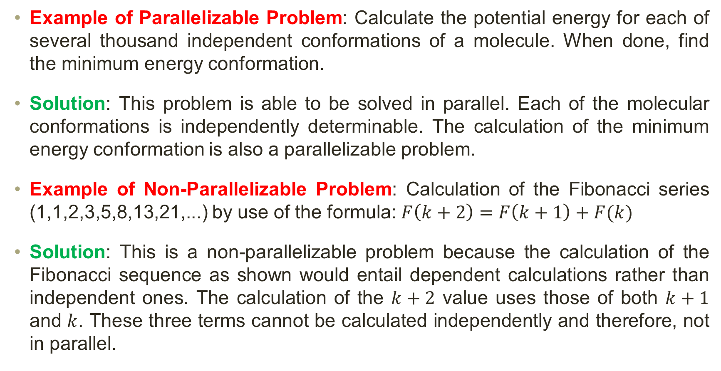
Understand the Problem and the Program
Example of Parallelizable Problem: Calculate the potential energy for each of several thousand independent conformations of a molecule. When done, find the minimum energy conformation.
Solution: This problem is able to be solved in parallel. Each of the molecular conformations is independently determinable. The calculation of the minimum energy conformation is also a parallelizable problem.
Example of Non-Parallelizable Problem: Calculation of the Fibonacci series (1,1,2,3,5,8,13,21,...) by use of the formula: $F\left(k+2\right)=F\left(k+1\right)+F(k)$
Solution: This is a non-parallelizable problem because the calculation of the Fibonacci sequence as shown would entail dependent calculations rather than independent ones. The calculation of the $k+2$ value uses those of both $k+1$ and $k$. These three terms cannot be calculated independently and therefore, not in parallel.

Slide 8
Understand the Problem and the Program
Identify the program’s hotspots (These are parts of the code where most of the work or computation happens—the parts that consume the most CPU time).
  Know where most of the real work is being done. The majority of scientific and technical programs usually accomplish most of their work in a few places.
  Profilers and performance analysis tools can help here.
  Focus on parallelizing the hotspots and ignore those sections of the program that account for little CPU usage.
Identify bottlenecks in the program
  These are areas that slow down the program or prevent it from running efficiently in parallel. For example, I/O is usually something that slows a program down.
  May be possible to restructure the program or use a different algorithm to reduce or eliminate unnecessary slow areas.
Identify inhibitors to parallelism. One common class of inhibitor is data dependence, as demonstrated by the Fibonacci sequence above.
Investigate other algorithms if possible. This may be the single most important consideration when designing a parallel application.

Slide 9
Partitioning
One of the first steps in designing a parallel program is to break the problem into discrete "chunks" of work that can be distributed to multiple tasks. This is known as decomposition or partitioning.
There are two basic ways to partition computational work among parallel tasks:
  Domain Decomposition
  Functional Decomposition

Slide 10
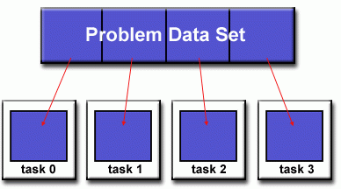
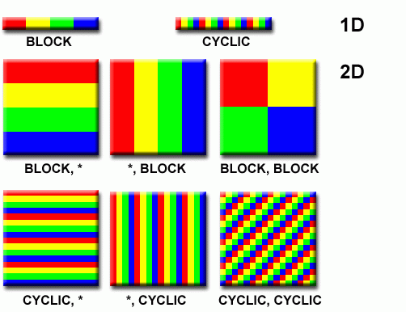
Partitioning
Domain Decomposition: In this type of partitioning, the data associated with a problem is decomposed. Each parallel task then works on a portion of the data.
There are different ways to partition data

Slide 11
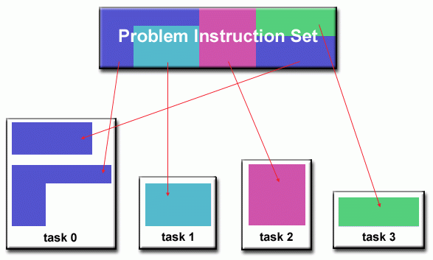
Partitioning
Functional Decomposition: In this approach, the focus is on the computation that is to be performed rather than on the data manipulated by the computation. The problem is decomposed according to the work that must be done. Each task then performs a portion of the overall work.
Functional decomposition lends itself well to problems that can be split into different tasks. For example:
  Ecosystem Modeling
  Signal Processing
  Climate Modeling

Slide 12
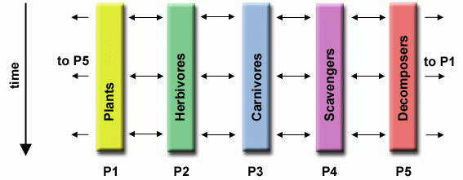
Partitioning
Ecosystem Modeling Example: Each program calculates the population of a given group, where each group's growth depends on that of its neighbors. As time progresses, each process calculates its current state, then exchanges information with the neighbor populations. All tasks then progress to calculate the state at the next time step.

Slide 13
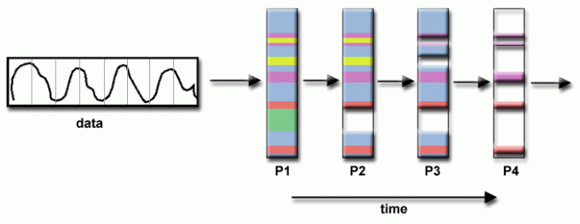
Partitioning
Signal Processing Example: An audio signal data set is passed through four distinct computational filters. Each filter is a separate process. The first segment of data must pass through the first filter before progressing to the second. When it does, the second segment of data passes through the first filter. By the time, the fourth segment of data is in the first filter, all four tasks are busy.

Slide 14
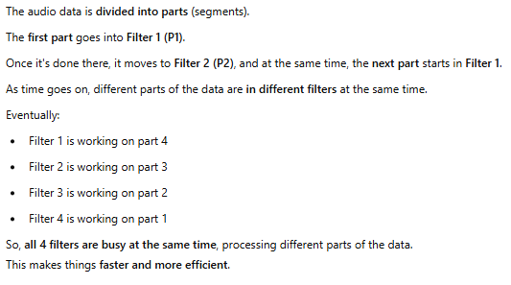
Partitioning

Slide 15
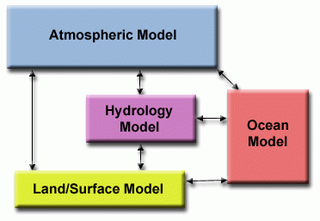

Partitioning
Climate Modeling Example: Each model component can be thought of as a separate task. Arrows represent exchanges of data between components during computation: the atmosphere model generates wind velocity data that are used by the ocean model, the ocean model generates sea surface temperature data that are used by the atmosphere model, and so on.
Combining these two types of problem decomposition is common and natural.

Slide 16
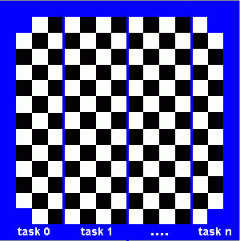
Who Needs Communications?
The need for communications between tasks depends upon your problem
You DON’T need communications
  Some types of problems can be decomposed and executed in parallel with virtually no need for tasks to share data. These types of problems are often called embarrassingly parallel as little, or no communication is required.
  For example, imagine an image processing operation where every pixel in a black and white image needs to have its color reversed. The image data can easily be distributed to multiple tasks that then act independently of each other to do their portion of the work.

Slide 17
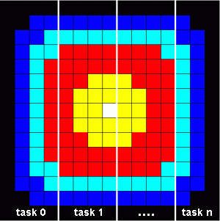
Who Needs Communications?
You DO need communications
  Most parallel applications are not quite so simple and do require tasks to share data with each other.
  For example, a 2-D heat diffusion problem requires a task to know the temperatures calculated by the tasks that have neighboring data. Changes to neighboring data has a direct effect on that task's data.

Slide 18
Factors to Consider (1)
There are several important factors to consider when designing your program's inter-task communications
Cost of Communications:
  Inter-task communication virtually always implies overhead.
  Machine cycles and resources that could be used for computation are instead used to package and transmit data.
  Communications frequently require some type of synchronization between tasks, which can result in tasks spending time "waiting" instead of doing work.
  Competing communication traffic can saturate the available network bandwidth, further aggravating performance problems.

Slide 19
Factors to Consider (2)
Latency vs. Bandwidth:
  Latency is the time it takes to send a minimal (0 byte) message from point A to point B. Commonly expressed as microseconds.
  Bandwidth is the amount of data that can be communicated per unit of time. Commonly expressed as megabytes/sec.
  Sending many small messages can cause latency to dominate communication overheads. Often it is more efficient to package small messages into a larger message, thus increasing the effective communications bandwidth.
Visibility of Communications:
  With the Message Passing Model, communications are explicit and generally quite visible and under the control of the programmer.
  With the Data Parallel Model, communications often occur transparently to the programmer, particularly on distributed memory architectures. The programmer may not even be able to know exactly how inter-task communications are being accomplished.

Slide 20
Factors to Consider (3)
Synchronous vs. Asynchronous Communications:
  Synchronous communications (Its like two people having a phone call) require some type of "handshaking" between tasks that are sharing data. This can be explicitly structured in code by the programmer, or it may happen at a lower-level unknown to the programmer.
  Synchronous communications are often referred to as blocking communications since other work must wait until the communications have completed.
  Asynchronous communications (It’s like sending a text message) allow tasks to transfer data independently from one another. For example, task 1 can prepare and send a message to task 2, and then immediately begin doing other work. When task 2 actually receives the data doesn't matter.
  Asynchronous communications are often referred to as non-blocking communications since other work can be done while the communications are taking place.
  Interleaving computation with communication is the single greatest benefit for using asynchronous communications.

Slide 21
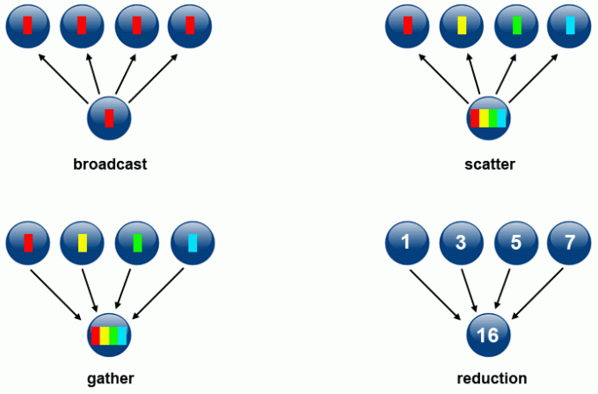
Factors to Consider (4)
Scope of Communications:
  Knowing which tasks must communicate with each other is critical during the design stage of a parallel code. Both of the two scopings described below can be implemented synchronously or asynchronously.
  Point-to-point – involves two tasks with one task acting as the sender/producer of data, and the other acting as the receiver/consumer.
  Collective – involves data sharing between more than two tasks, which are often specified as being members in a common group, or collective. Some common variations (there are more):

Slide 22
Factors to Consider (5)
Efficiency of Communications:
  Oftentimes, the programmer has choices that can affect communications performance. Only a few are mentioned here.
  Which implementation for a given model should be used? Using the Message Passing Model as an example, one MPI implementation may be faster on a given hardware platform than another.
  What type of communication operations should be used? As mentioned previously, asynchronous communication operations can improve overall program performance.
  Network media – different platforms use different networks. Some networks perform better than others. Choosing a platform with a faster network may be an option.

Slide 23
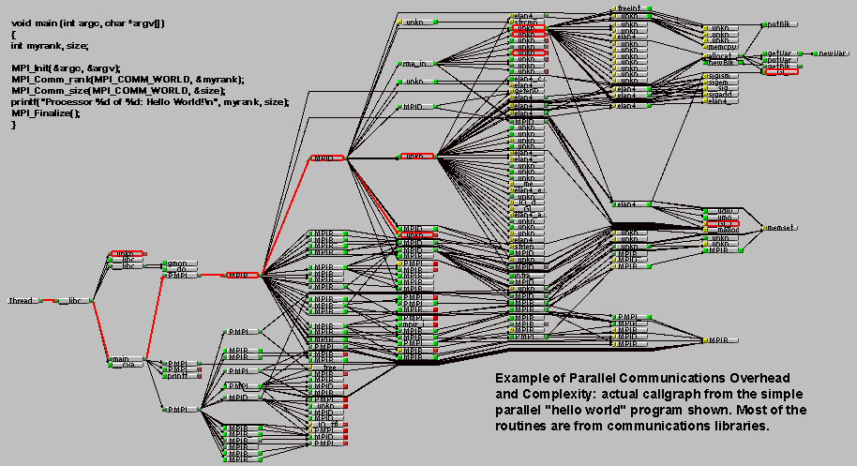
Factors to Consider (6)
Overhead and Complexity:

Slide 24
Factors to Consider (7)
Finally, realize that this is only a partial list of things to consider!!!

Slide 25
Types of Synchronization
Barrier:
  Usually implies that all tasks are involved.
  Each task performs its work until it reaches the barrier. It then stops, or "blocks".
  When the last task reaches the barrier, all tasks are synchronized and released.
Locks/Semaphore:
  Can involve any number of tasks
  Typically used to “protect” access to the critical section of code. Only one task at a time may use (own) the lock / semaphore / flag.
  The first task to acquire the lock "sets" it and then safely access the critical section.
  Other tasks attempting to acquire the lock must wait until the task owning the lock releases it.
  Can be blocking or non-blocking
Synchronization Communication Operations:
  Involves only those tasks executing a communication operation
  Tasks performing a communication operation between them require some form of coordination. For example, before a task can perform a send operation, it must first receive an acknowledgment from the receiving task that it is OK to send.

Slide 26
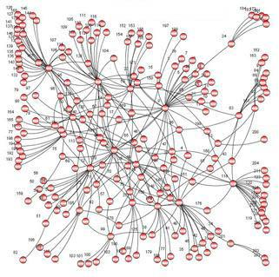
Data Dependencies
A dependence exists between program statements when the order of statement execution affects the results of the program.
A data dependence results from multiple use of the same location(s) in storage by different tasks.
Dependencies are important to parallel programming because they are one of the primary inhibitors to parallelism.

Slide 27
Example 1: Loop Carried Data Dependence
    DO 500 J = MYSTART,MYEND
      A(J) = A(J-1) * 2.0500
    CONTINUE
The value of A(J-1) must be computed before the value of A(J); therefore A(J) exhibits a data dependency on A(J-1). Parallelism is inhibited.
If Task 2 has A(J) and task 1 has A(J-1), computing the correct value of A(J) necessitates:
  Distributed memory architecture - task 2 must obtain the value of A(J-1) from task 1 after task 1 finishes its computation
  Shared memory architecture - task 2 must read A(J-1) after task 1 updates it

Slide 28
Example 2: Loop Independent Data Dependence
task 1 task 2
------ ------
X = 2 X = 4
. .
. .
Y = X**2 Y = X**3
As with the previous example, parallelism is inhibited. The value of Y is dependent on:
  Shared memory architecture - which task last stores the value of X.
  Distributed memory architecture – if or when the value of X is communicated between the tasks.
Although all data dependencies are important to identify when designing parallel programs, loop carried dependencies are particularly important since loops are possibly the most common target of parallelization efforts.

Slide 29
How to Handle Data Dependencies?
Distributed memory architectures – communicate required data at synchronization points.
Shared memory architectures -synchronize read/write operations between tasks.

Slide 30
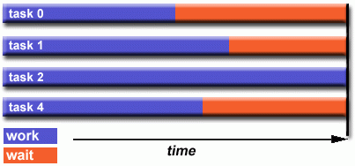
Load Balancing
Load balancing refers to the practice of distributing work among tasks so that all tasks are kept busy all the time. It can be considered a minimization of task idle time.
Load balancing is important to parallel programs for performance reasons. For example, if all tasks are subject to a barrier synchronization point, the slowest task will determine the overall performance.

Slide 31
How to Achieve Load Balance? (1)
Equally partition the work each task receives
  For array/matrix operations where each task performs similar work, evenly distribute the data set among the tasks.
  For loop iterations where the work done in each iteration is similar, evenly distribute the iterations across the tasks.
  If a heterogeneous mix of machines with varying performance characteristics are being used, be sure to use some type of performance analysis tool to detect any load imbalances. Adjust work accordingly.

Slide 32
How to Achieve Load Balance? (2)
Use dynamic work assignment
  Certain classes of problems result in load imbalances even if data is evenly distributed among tasks:
    Sparse arrays – some tasks have actual data to work on while others have mostly "zeros".
    Adaptive grid methods - some tasks may need to refine their mesh while others don't.
    N-body simulations - where some particles may migrate to/from their original task domain to another task's; where the particles owned by some tasks require more work than those owned by other tasks.
  When the amount of work each task will perform is intentionally variable, or is unable to be predicted, it may be helpful to use a scheduler – task pool approach. As each task finishes its work, it queues to get a new piece of work.
  It may become necessary to design an algorithm which detects and handles load imbalances as they occur dynamically within the code.

Slide 33
Granularity
Computation/Communication Ratio:
  In parallel computing, granularity is a qualitative measure of the ratio of computation to communication.
  Periods of computation are typically separated from periods of communication by synchronization events.
Fine-grain Parallelism
Coarse-grain Parallelism

Slide 34
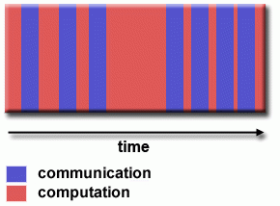
Fine-grain Parallelism
Relatively small amounts of computational work are done between communication events
Low computation to communication ratio
Facilitates load balancing
Implies high communication overhead and less opportunity for performance enhancement
If granularity is too fine, it is possible that the overhead required for communications and synchronization between tasks takes longer than the computation.

Slide 35
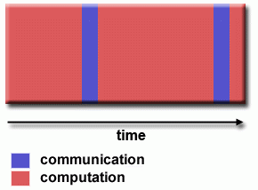
Coarse-grain Parallelism
Relatively large amounts of computational work are done between communication/synchronization events
High computation to communication ratio
Implies more opportunity for performance increase
Harder to load balance efficiently

Slide 36
Which is Best?
The most efficient granularity is dependent on the algorithm and the hardware environment in which it runs.
In most cases the overhead associated with communications and synchronization is high relative to execution speed, so it is advantageous to have coarse granularity.
Fine-grain parallelism can help reduce overheads due to load imbalance.

Slide 37
I/O
The bad News:
  I/O operations are generally regarded as inhibitors to parallelism
  Parallel I/O systems are immature or not available for all platforms
  In an environment where all tasks see the same filespace, write operations will result in file overwriting
  Read operations will be affected by the fileserver's ability to handle multiple read requests at the same time
  I/O that must be conducted over the network (NFS, non-local) can cause severe bottlenecks

Slide 38
I/O
The good News: Some parallel file systems are available. For example:
  GPFS: General Parallel File System for AIX (IBM)
  Lustre: for Linux clusters (Cluster File Systems, Inc.)
  PVFS/PVFS2: Parallel Virtual File System for Linux clusters (Clemson/Argonne/Ohio State/others)
  PanFS: Panasas ActiveScale File System for Linux clusters (Panasas, Inc.)
  HP SFS: HP StorageWorks Scalable File Share. Lustre based parallel file system (Global File System for Linux) product from HP
The parallel I/O programming interface specification for MPI has been available since 1996 as part of MPI-2. Vendor and "free" implementations are now commonly available.

Slide 39
Some Options
Rule #1: Reduce overall I/O as much as possible
Writing large chunks of data rather than small chunks is usually significantly more efficient.
Fewer, larger files performs better than many small files.
Confine I/O to specific serial portions of the job and then use parallel communications to distribute data to parallel tasks; e.g., Task 1 could read an input file and then communicate required data to other tasks. Likewise, Task 1 could perform write operation after receiving required data from all other tasks.
For distributed memory systems with shared filespace, perform I/O in local, non-shared filespace. For example, each processor may have /tmp filespace which can used. This is usually much more efficient than performing I/O over the network to one's home directory.
Create unique filenames for each tasks' input/output file(s)
Aggregate I/O operations across tasks - rather than having many tasks perform I/O, have a subset of tasks perform it.

Slide 40
Performance Analysis and Tuning
Analyzing and tuning parallel program performance can be much more challenging than for serial programs.
Fortunately, there are a number of excellent tools for parallel program performance analysis and tuning.
  TAU: http://www.cs.uoregon.edu/research/tau/docs.php
  HPCToolkit: http://hpctoolkit.org/documentation.html
  Open|Speedshop: https://www.openspeedshop.org/
  Vampir / Vampirtrace: http://vampir.eu/
  Valgrind: http://valgrind.org/
  PAPI: http://icl.cs.utk.edu/papi/
  mpiP: http://mpip.sourceforge.net/
  memP: http://memp.sourceforge.net/

Slide 41
Limits and Costs of Parallel Programming
Complexity: In general, parallel applications are much more complex than corresponding serial applications, perhaps an order of magnitude. Not only do you have multiple instruction streams executing at the same time, but you also have data flowing between them.
The costs of complexity are measured in programmer time in virtually every aspect of the software development cycle:
  Design
  Coding
  Debugging
  Tuning
  Maintenance
Adhering to "good" software development practices is essential when working with parallel applications - especially if somebody besides you will have to work with the software.

Slide 42
Limits and Costs of Parallel Programming
Portability (Portability means how easily a program can run on different computers or systems without needing to be changed a lot): Thanks to standardization in several APIs, such as MPI, POSIX threads, HPF and OpenMP, portability issues with parallel programs are not as serious as in years past. However...
All of the usual portability issues associated with serial programs apply to parallel programs. For example, if you use vendor "enhancements" to Fortran, C or C++, portability will be a problem.
Even though standards exist for several APIs, implementations will differ in a number of details, sometimes to the point of requiring code modifications in order to effect portability.
Operating systems can play a key role in code portability issues.
Hardware architectures are characteristically highly variable and can affect portability.

Slide 43
Limits and Costs of Parallel Programming
Resource Requirement: The primary intent of parallel programming is to decrease execution wall clock time, however in order to accomplish this, more CPU time is required. For example, a parallel code that runs in 1 hour on 8 processors actually uses 8 hours of CPU time.
The amount of memory required can be greater for parallel codes than serial codes, due to the need to replicate data and for overheads associated with parallel support libraries and subsystems.
For short running parallel programs, there can actually be a decrease in performance compared to a similar serial implementation. The overhead costs associated with setting up the parallel environment, task creation, communications and task termination can comprise a significant portion of the total execution time for short runs.

Slide 44
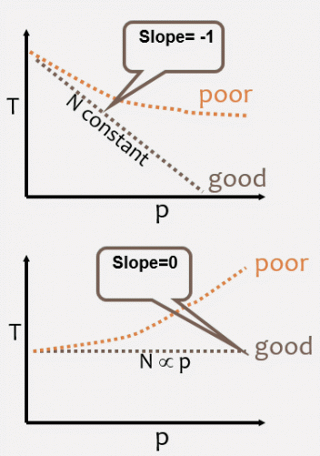
Limits and Costs of Parallel Programming
Scalability (Scalability is about how well a parallel program performs when we increase the number of processors) : Two types of scaling based on time to solution:
Strong Scaling
  The total problem size stays fixed as more processors are added.
  The goal is to reduce the execution time.
  Perfect scaling means if a single processor takes T time, then P processors should solve it in T/P time.
Weak Scaling
  The problem size grows as we add more processors. The goal is to keep execution time the same, even as the problem grows.
  The total problem size is proportional to the number of processors used.
  Goal is to run larger problem in same amount of time
  Perfect scaling means if 1 processor takes T time for a small problem, P processors should take the same T time for a problem that is P times bigger.

Slide 45
Limits and Costs of Parallel Programming
Scalability Isn't Just About Adding More Machines
Adding more machines doesn't always mean you'll get better performance. There are many interrelated factors such as hardware, software, and the nature of the algorithm that control scalability.
  Some algorithms have inherent limits. For example: Certain parts of a program cannot be parallelized. After a point, adding more processors might increase communication and coordination overhead, making performance worse, not better.
  Hardware factors play a significant role in scalability. Examples:
    In SMP machines (Symmetric Multiprocessing), all processors share the same bus to access memory. If many processors compete for the bus, bandwidth becomes a bottleneck.
    In distributed systems or clusters, processors communicate over a network. If the network has limited bandwidth, communication becomes slow, limiting performance.
    If there's not enough memory per machine or node, processors spend time waiting to access memory, reducing scalability.
    Faster processors help, but if communication is slow, even a fast CPU will spend time idle, waiting for data.

Slide 46
Limits and Costs of Parallel Programming
  Parallel support libraries and subsystems (like MPI or OpenMP) may have overhead. They manage tasks, synchronize processors, and handle communication, but this adds extra computation and can limit the speedup you get.

Slide 47
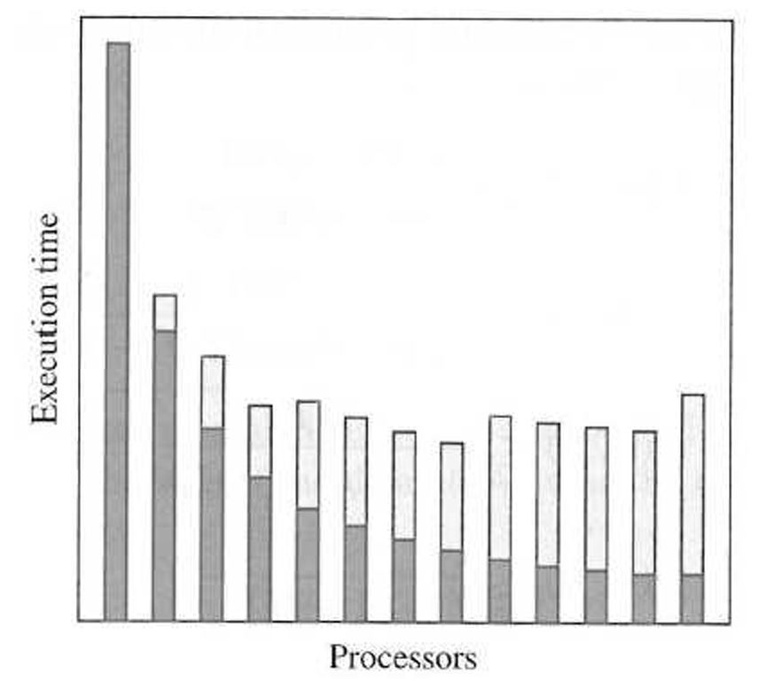
Limits and Costs of Parallel Programming
Dark Grey: Time spent on computation, decreasing with # of processors
White: Time spent on communication, increasing with # of processors
Operations in a parallel program:
  Computation that must be performed sequentially
  Computations that can be performed in parallel
  Parallel overhead including communication and redundant computations

Slide 48
Limits and Costs of Parallel Programming
How can we quantify the possible gains from parallelization?
Amdahl’s Law (strong scaling)
  Analyze whether a program merits parallelization
Gustafson-Barsis’s Law (weak scaling)
  Evaluate performance of a parallel program
Karp-Flatt metric
  Calculates the serial fraction for a given parallel configuration and determines whether the principal barrier to speedup is due to inherently sequential code or parallelization overhead
Isoefficiency metric
  Evaluate the scalability of a parallel program executing on a parallel computer

Slide 49
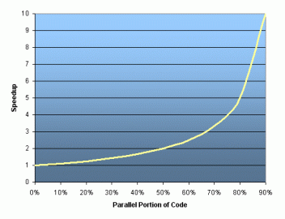
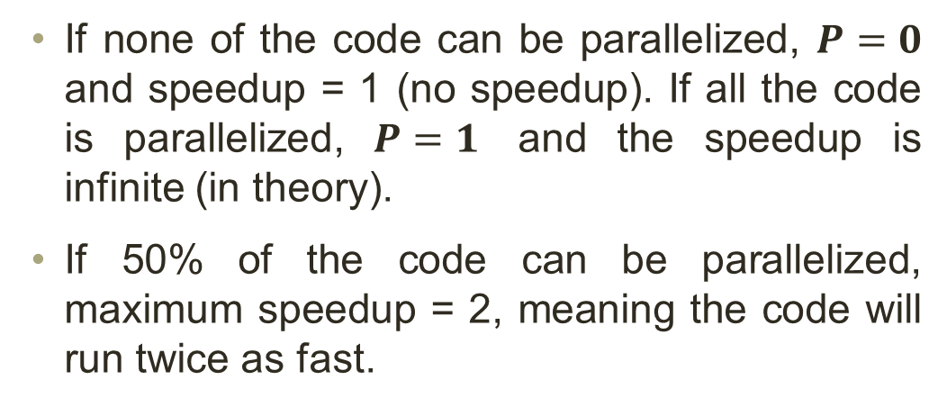
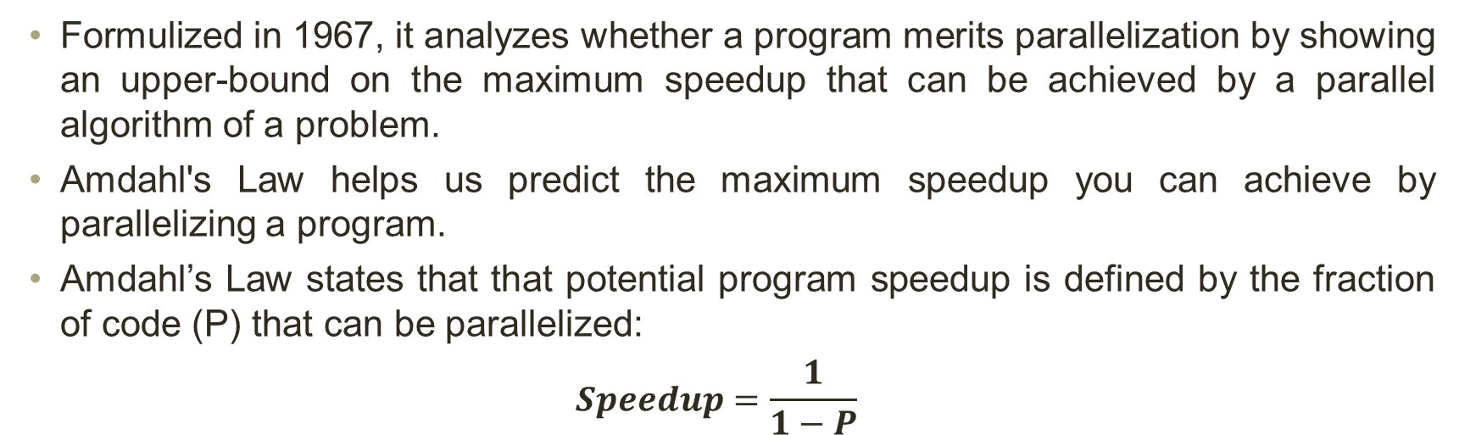
Amdahl’s Law
Formulized in 1967, it analyzes whether a program merits parallelization by showing an upper-bound on the maximum speedup that can be achieved by a parallel algorithm of a problem.
Amdahl's Law helps us predict the maximum speedup you can achieve by parallelizing a program.
Amdahl’s Law states that that potential program speedup is defined by the fraction of code (P) that can be parallelized:
$$Speedup=\frac{1}{1−P}$$
If none of the code can be parallelized, $P=0$ and speedup = 1 (no speedup). If all the code is parallelized, $P=1$ and the speedup is infinite (in theory).
If 50% of the code can be parallelized, maximum speedup = 2, meaning the code will run twice as fast.

Slide 50
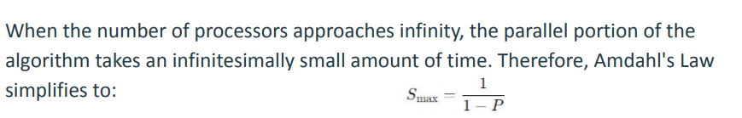
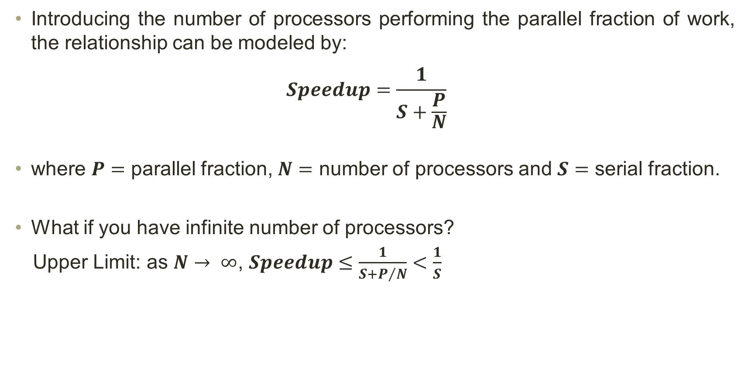
Amdahl’s Law
Introducing the number of processors performing the parallel fraction of work, the relationship can be modeled by:
$$Speedup=\frac{1}{S+\frac{P}{N}}$$
where $P=$ parallel fraction, $N=$ number of processors and $S=$ serial fraction.
What if you have infinite number of processors?
Upper Limit: as $N→ ∞$, $Speedup≤\frac{1}{S+P/N}<\frac{1}{S}$

Slide 51
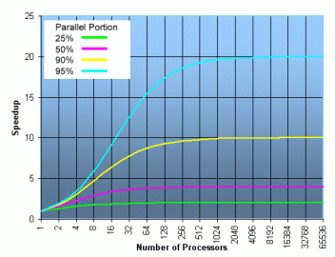
Speedup vs. P
Amdahl’s law assumes that the problem size is fixed. It provides an upper bound on the speedup achievable by applying a certain number of processors.

Slide 52

Amdahl’s Law
Example 1: If 90% of the computation can be parallelized, what is the maximum speedup achievable using 8 processors?
Solution:
  $P=90\%$
  $$Speedup≤\frac{1}{\left(1−0.9\right)+{0.9}/8} ≈4.7$$

Slide 53

Amdahl’s Law
Example 2: Suppose 25% of a sequential algorithm is the parallelizable portion. The remaining part must be calculated sequentially. Calculate maximum theoretical speedup for parallel variant of this algorithm using:
  5 processors

Slide 54
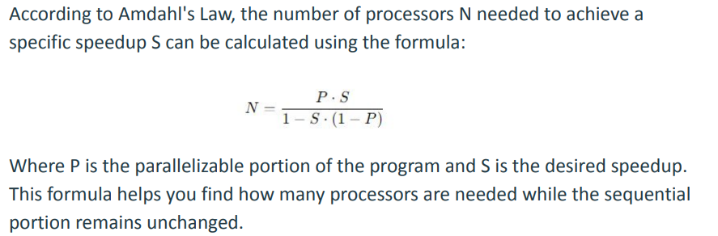
Amdahl’s Law
Little challenge: Determine, according to Amdahl’s law, how many processors are needed to achieve maximum theoretical speedup while sequential portion remains the same?
  That is why we say actual achievable speedup is always less than or equal to theoretical speedups

Slide 55
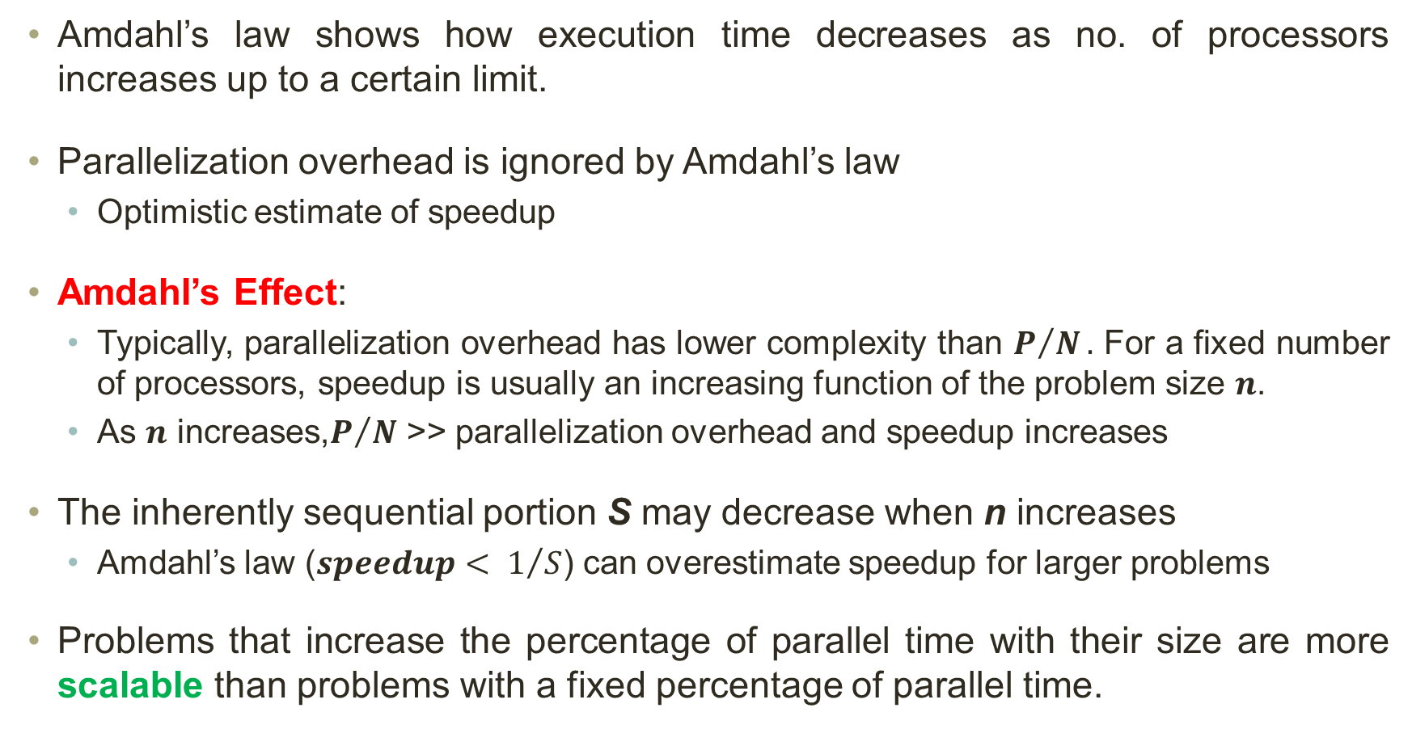
Amdahl’s Law: Remarks
Amdahl’s law shows how execution time decreases as no. of processors increases up to a certain limit.
Parallelization overhead is ignored by Amdahl’s law
  Optimistic estimate of speedup
Amdahl’s Effect:
  Typically, parallelization overhead has lower complexity than $P/N.$ For a fixed number of processors, speedup is usually an increasing function of the problem size 𝒏.
  As 𝒏 increases,$P/N$ >> parallelization overhead and speedup increases
The inherently sequential portion S may decrease when n increases
  Amdahl’s law ($speedup< 1/S$) can overestimate speedup for larger problems
Problems that increase the percentage of parallel time with their size are more scalable than problems with a fixed percentage of parallel time.

Slide 56
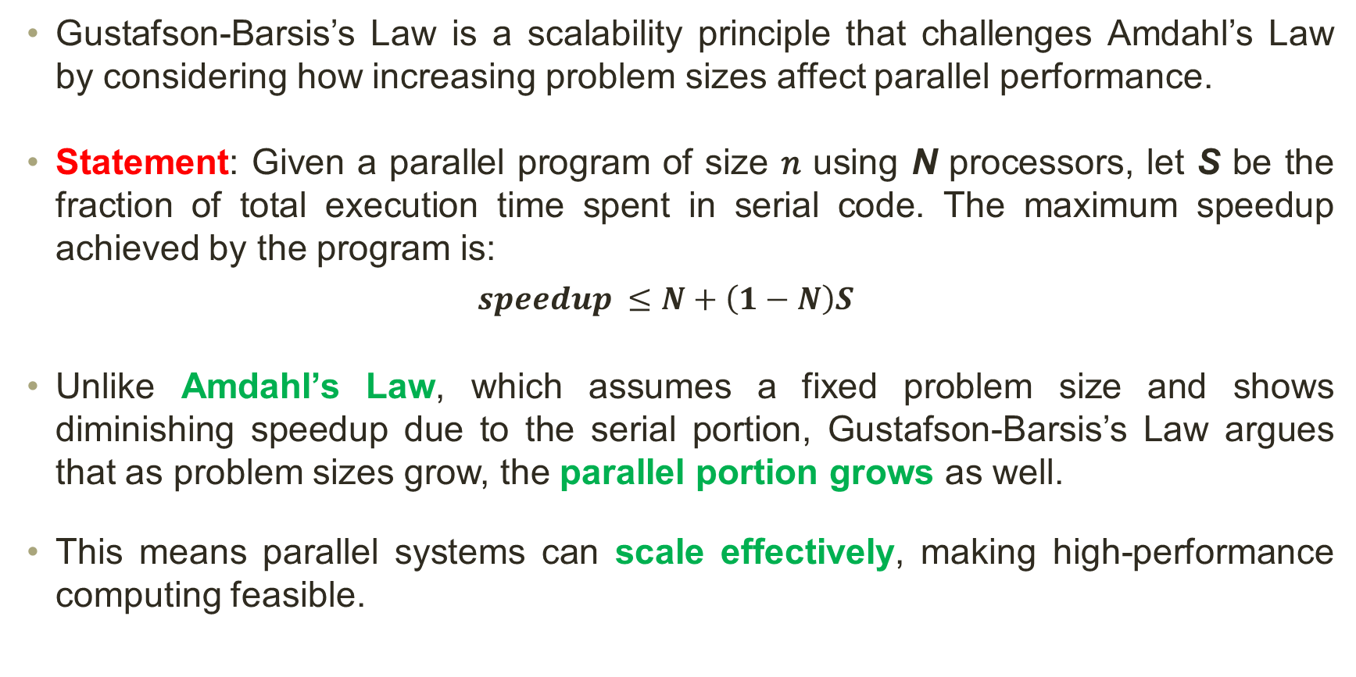
Gustafson-Barsis’s Law
Gustafson-Barsis’s Law is a scalability principle that challenges Amdahl’s Law by considering how increasing problem sizes affect parallel performance.
Statement: Given a parallel program of size 𝑛 using N processors, let S be the fraction of total execution time spent in serial code. The maximum speedup achieved by the program is:
$$speedup ≤N+\left(1−N\right)S$$
Unlike Amdahl’s Law, which assumes a fixed problem size and shows diminishing speedup due to the serial portion, Gustafson-Barsis’s Law argues that as problem sizes grow, the parallel portion grows as well.
This means parallel systems can scale effectively, making high-performance computing feasible.

Slide 57
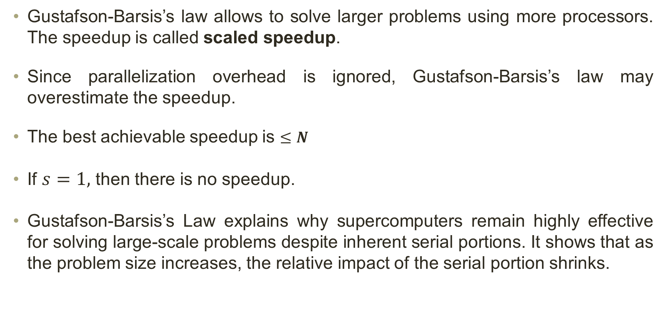
Gustafson-Barsis’s Law: Remarks
Gustafson-Barsis’s law allows to solve larger problems using more processors. The speedup is called scaled speedup.
Since parallelization overhead is ignored, Gustafson-Barsis’s law may overestimate the speedup.
The best achievable speedup is $≤N$
If $s=1,$ then there is no speedup.
Gustafson-Barsis’s Law explains why supercomputers remain highly effective for solving large-scale problems despite inherent serial portions. It shows that as the problem size increases, the relative impact of the serial portion shrinks.

Slide 58

Gustafson-Barsis’s Law: Remarks
Example: An application executing on 64 processors using 5% of the total time on non-parallelizable computations. What is the scaled speedup?
Solution:
  $S=0.05$
  $$Speedup ≤N+\left(1−N\right)S$$
  $$=64+\left(1−64\right)(0.05) ≈60.85$$

Slide 59
Karp-Flatt Metric
Both Amdahl’s law and Gustafson-Barsis’s law ignore the parallelization overhead and overestimate the achievable speedup.
Karp-Flatt metric is used to measure the effectiveness of parallel computing by analyzing how much serial overhead affects speedup. It helps determine whether a parallel system is limited by inherent sequential portions or by inefficiencies like parallelization overhead.
  Process startup time
  Process synchronization time
  Communication overhead
  Imbalanced workload
  Architectural overhead

Slide 60
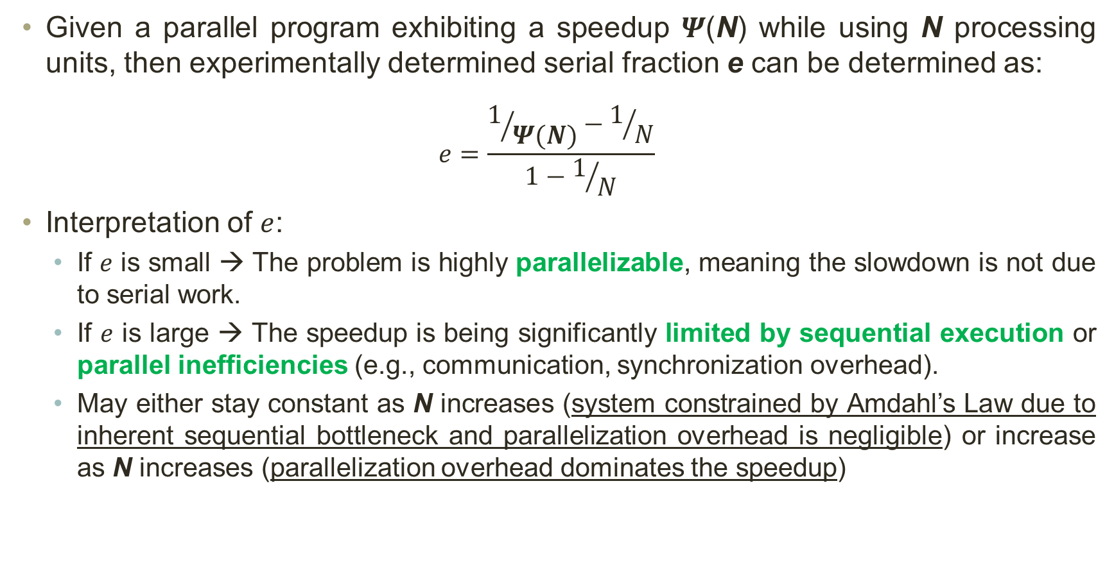
Karp-Flatt Metric
Given a parallel program exhibiting a speedup $Ψ$(N) while using N processing units, then experimentally determined serial fraction e can be determined as:
$$e=\frac{1/{Ψ(N)}−1/N}{1−1/N}$$
Interpretation of $e$:
  If $e$ is small → The problem is highly parallelizable, meaning the slowdown is not due to serial work.
  If $e$ is large → The speedup is being significantly limited by sequential execution or parallel inefficiencies (e.g., communication, synchronization overhead).
  May either stay constant as N increases (system constrained by Amdahl’s Law due to inherent sequential bottleneck and parallelization overhead is negligible) or increase as N increases (parallelization overhead dominates the speedup)

Slide 61

Karp-Flatt Metric
Example 1: Suppose in a parallel program, for 5 processors, you gained a speedup of 1.25x, determine sequential fraction of your program
Solution:
$$e=\frac{1/{1.25}−1/5}{1−1/5}≈0.75$$

Slide 62
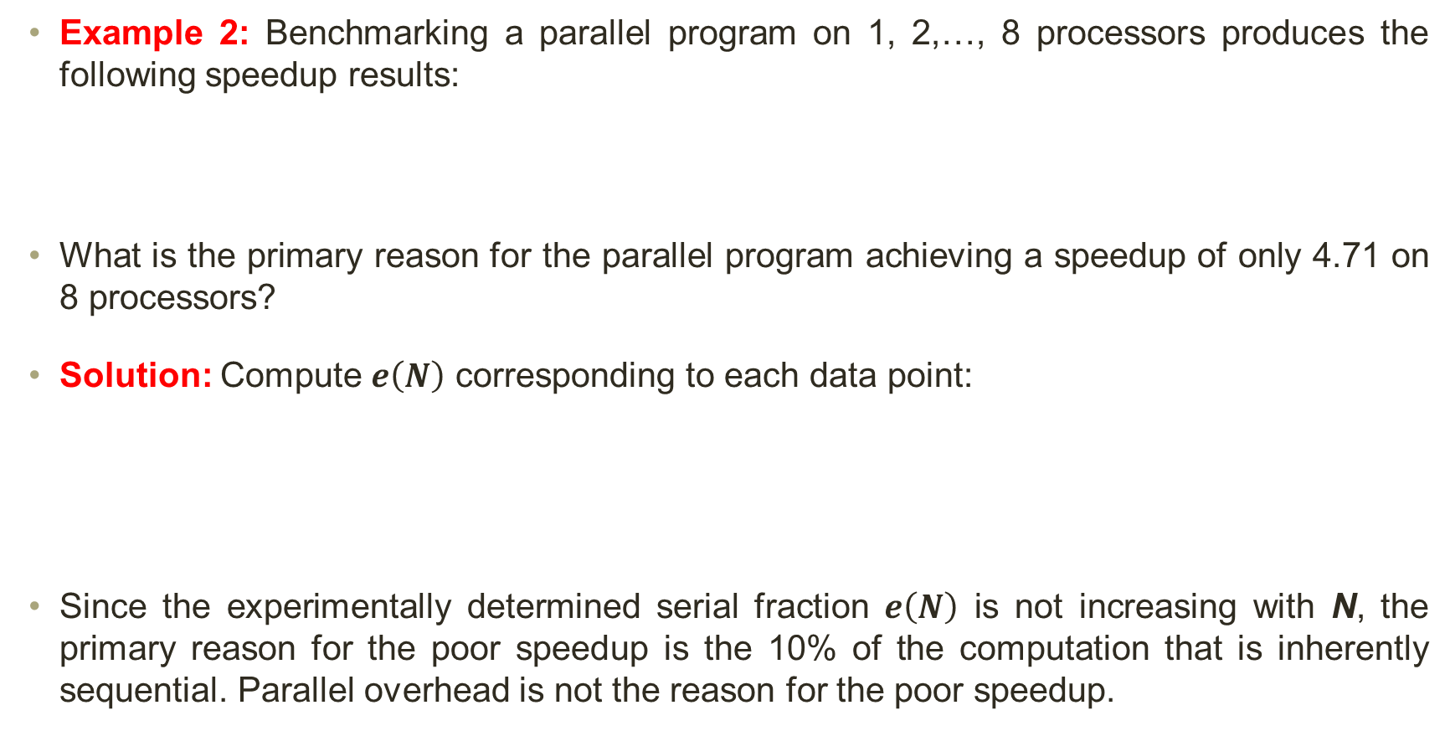
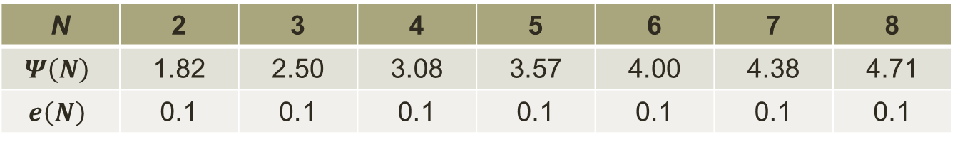
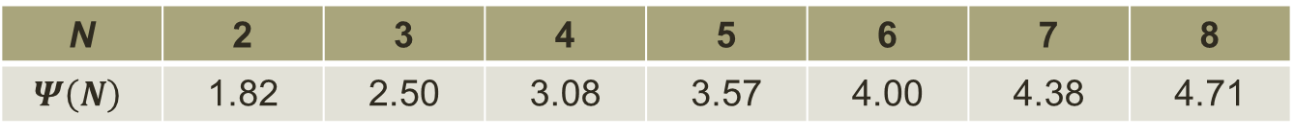
Karp-Flatt Metric
Example 2: Benchmarking a parallel program on 1, 2,…, 8 processors produces the following speedup results:
What is the primary reason for the parallel program achieving a speedup of only 4.71 on 8 processors?
Solution: Compute $e\left(N\right)$ corresponding to each data point:
Since the experimentally determined serial fraction $e\left(N\right)$ is not increasing with N, the primary reason for the poor speedup is the 10% of the computation that is inherently sequential. Parallel overhead is not the reason for the poor speedup.
N | 2 | 3 | 4 | 5 | 6 | 7 | 8
$$Ψ\left(N\right)$$ | 1.82 | 2.50 | 3.08 | 3.57 | 4.00 | 4.38 | 4.71
N | 2 | 3 | 4 | 5 | 6 | 7 | 8
$$Ψ\left(N\right)$$ | 1.82 | 2.50 | 3.08 | 3.57 | 4.00 | 4.38 | 4.71
$$e\left(N\right)$$ | 0.1 | 0.1 | 0.1 | 0.1 | 0.1 | 0.1 | 0.1

Slide 63
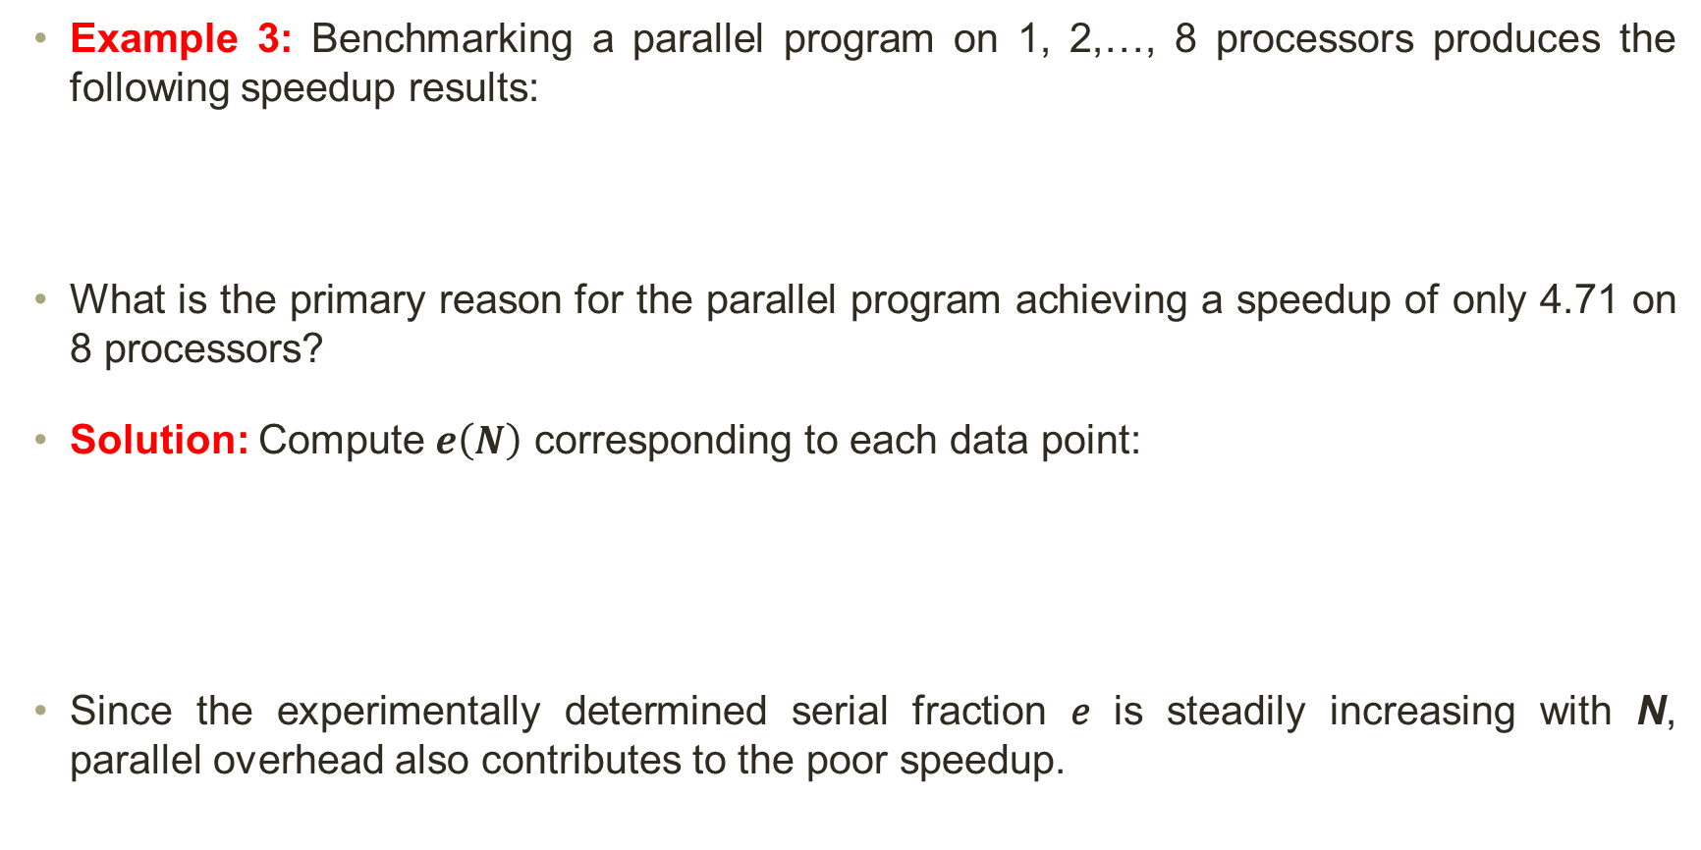
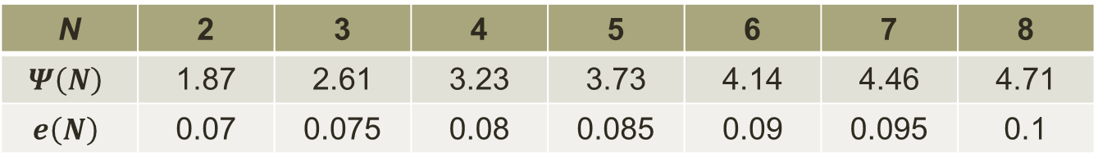
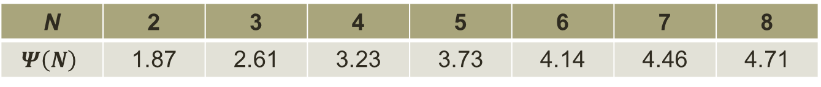
Karp-Flatt Metric
Example 3: Benchmarking a parallel program on 1, 2,…, 8 processors produces the following speedup results:
What is the primary reason for the parallel program achieving a speedup of only 4.71 on 8 processors?
Solution: Compute $e\left(N\right)$ corresponding to each data point:
Since the experimentally determined serial fraction 𝑒 is steadily increasing with N, parallel overhead also contributes to the poor speedup.
N | 2 | 3 | 4 | 5 | 6 | 7 | 8
$$Ψ\left(N\right)$$ | 1.87 | 2.61 | 3.23 | 3.73 | 4.14 | 4.46 | 4.71
N | 2 | 3 | 4 | 5 | 6 | 7 | 8
$$Ψ\left(N\right)$$ | 1.87 | 2.61 | 3.23 | 3.73 | 4.14 | 4.46 | 4.71
$$e\left(N\right)$$ | 0.07 | 0.075 | 0.08 | 0.085 | 0.09 | 0.095 | 0.1

Slide 64
Isoefficiency Metric
Scalability of a parallel system is a measure of its ability to increase performance as the number of processors increases. Isoefficiency metric is used to evaluate the scalability of a parallel system.
A scalable system should maintain efficiency as # of processors (N) is increased. Isoefficiency metric tells us how much we need to increase the problem size or computational work (W) to maintain a constant efficiency (E) as we add more processors.
Isoefficiency function (W) describes how W should grow relative to N. A lower value of W means better scalability.
Isoefficiency tells us how much harder we need to work (increase W) to make use of more processors without losing efficiency.

Slide 65
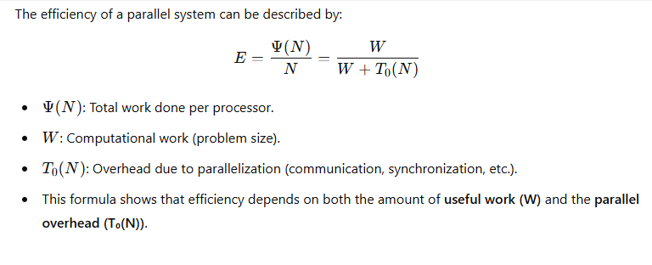
Isoefficiency Metric Equation

Slide 66

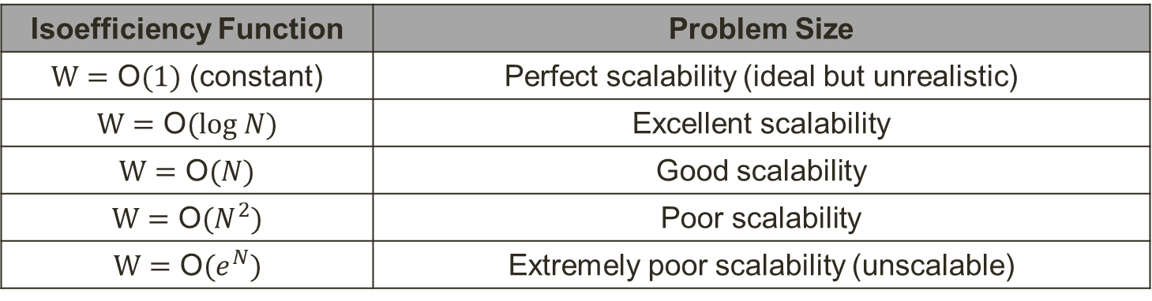
Isoefficiency Metric
For a system to be scalable, the problem size (W) must grow at least as fast as the total parallelization overhead $T_{0}\left(N\right)$.
$$W≥\text{Θ}(T_{0}\left(N\right))$$
Remarks on Isoefficiency:
  Determines if adding more processors is beneficial.
  Helps in designing scalable parallel algorithms.
  Shows the cost of parallelization overhead (communication, load balancing, etc.).
Isoefficiency Function | Problem Size
$W=\text{O}(1)$ (constant) | Perfect scalability (ideal but unrealistic)
$W=\text{O}(log N)$ | Excellent scalability
$W=\text{O}(N)$ | Good scalability
$W=\text{O}(N^{2})$ | Poor scalability
$W=\text{O}(e^{N})$ | Extremely poor scalability (unscalable)

Slide 67
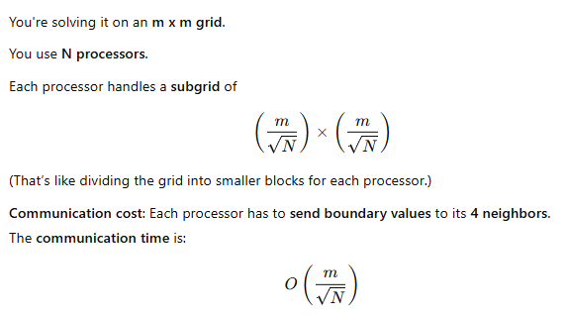


Isoefficiency Metric
Example: The Explicit Finite Difference problem is solved on a $m×m$ grid using $N$ processors. Each processor is responsible for a subgrid of size $\left(m/{\sqrt{N}})×{(m}/{\sqrt{N}}\right).$ During each time step, every processor sends boundary values to its four neighbors for which the required communication time is ${\text{O}(m}/{\sqrt{N}})$. Find the isoefficiency function.
Solution:

Slide 68

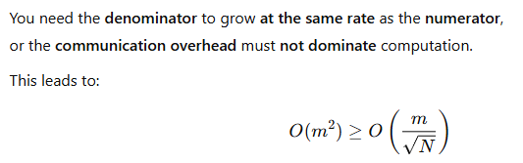

Isoefficiency Metric
Example: The Explicit Finite Difference problem is solved on a $m×m$ grid using $N$ processors. Each processor is responsible for a subgrid of size $\left(m/{\sqrt{N}})×{(m}/{\sqrt{N}}\right).$ During each time step, every processor sends boundary values to its four neighbors for which the required communication time is ${\text{O}(m}/{\sqrt{N}})$. Find the isoefficiency function.
Solution:

Slide 69

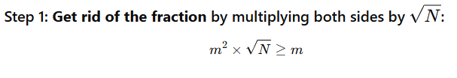

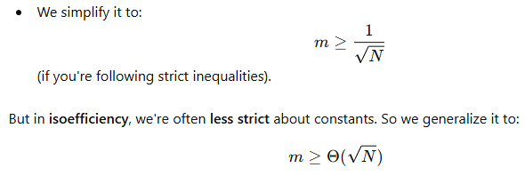


Isoefficiency Metric

